Slide 1
Data Mining and Machine Learning
Project 1: Clustering
Notes:
Engin

Slide 2
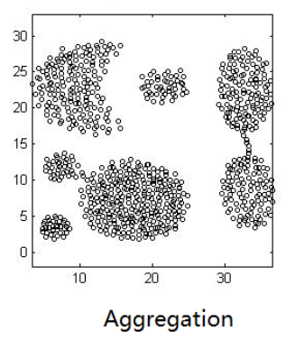
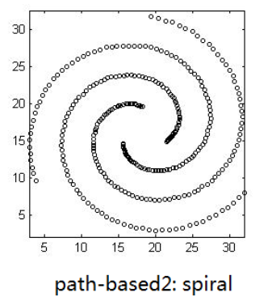
Why these data sets ?
Interesting
Different
Notes:
Engin

Slide 3
Which algorithms? Which implementations?
KMeans (Lloyd/Forgy)
  Pros: Simple, fast, easy to use.
  Cons: Only finds round-shaped clusters. Needs k given.
  Time complexity: fast for small and medium data, but if k is big or data big, it can slow down.
EM (Gaussian Mixture Modeling)
  Pros: Works well with overlapping clusters.
  Cons: Also needs k. Slower than KMeans.
  Time complexity: slower than KMeans because it does more calculations. Needs more time when clusters overlap or when dimensions are high.
DBSCAN
  Pros: Finds clusters of any shape. No need to give k. Can also detect noise.
  Cons: Sensitive to parameters (epsilon and minPoints). Hard with different densities.
  Time complexity: Fast if data is small and parameters are good. But can be slow if there are a lot of points because it checks neighbors for each point.
Notes:
Engin

Slide 4
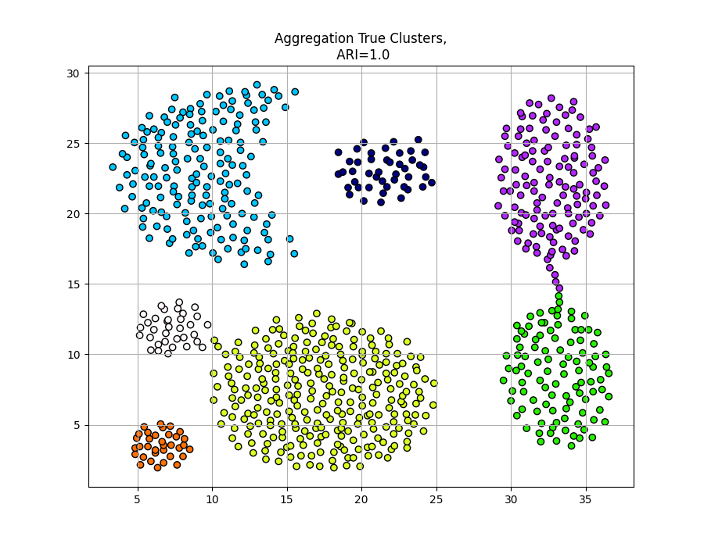
Aggregation Dataset True Labels
Notes:
William

Slide 5
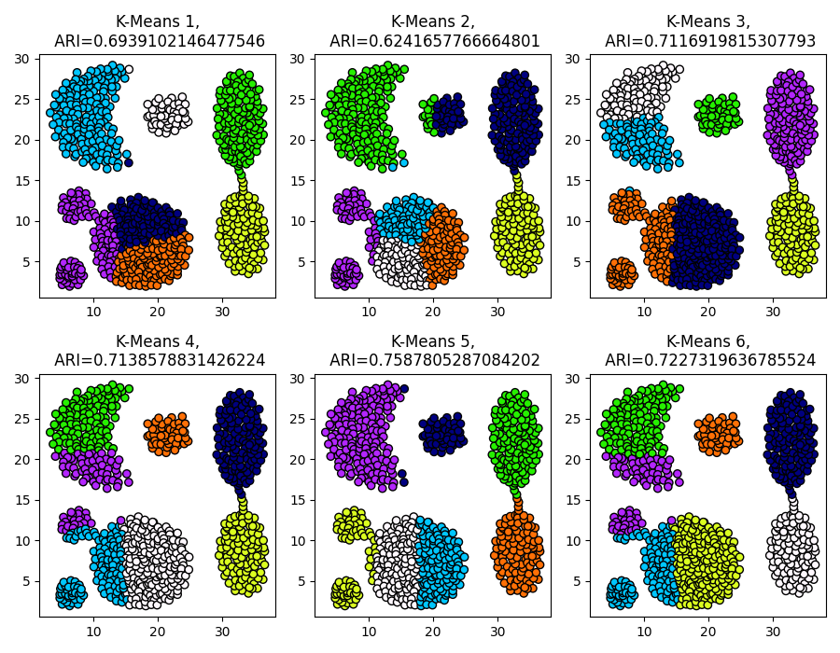
KMeans
Clustering
results
Notes:
William

Slide 6
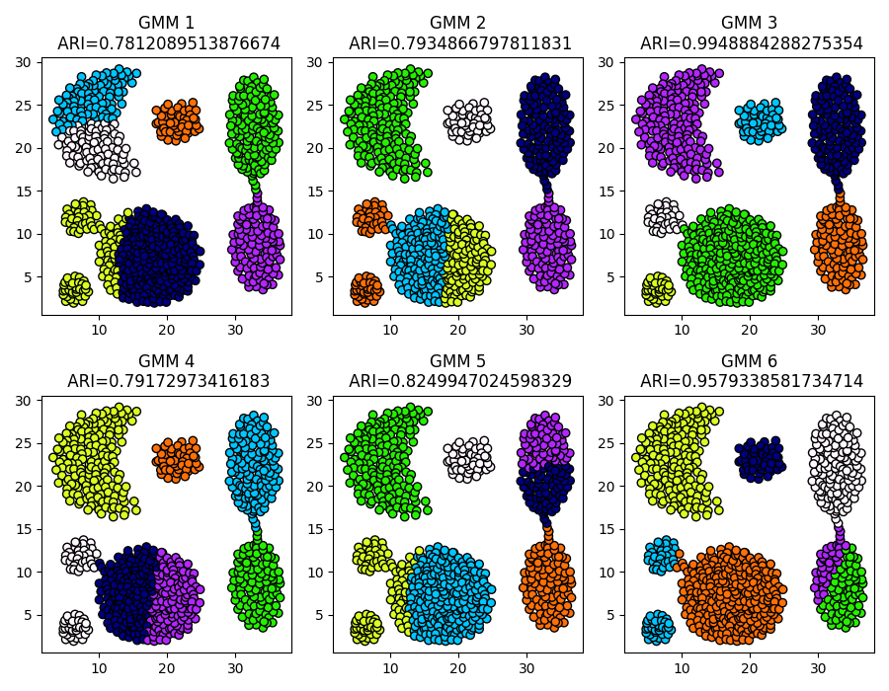
EM
Clustering
results
Notes:
William

Slide 7
Hybrid Clustering
A combination of KMeans and EM clustering.
We use KMeans to obtain starting points. We then use those points as initial parameters to cluster the dataset with EM clustering.
Notes:
William

Slide 8
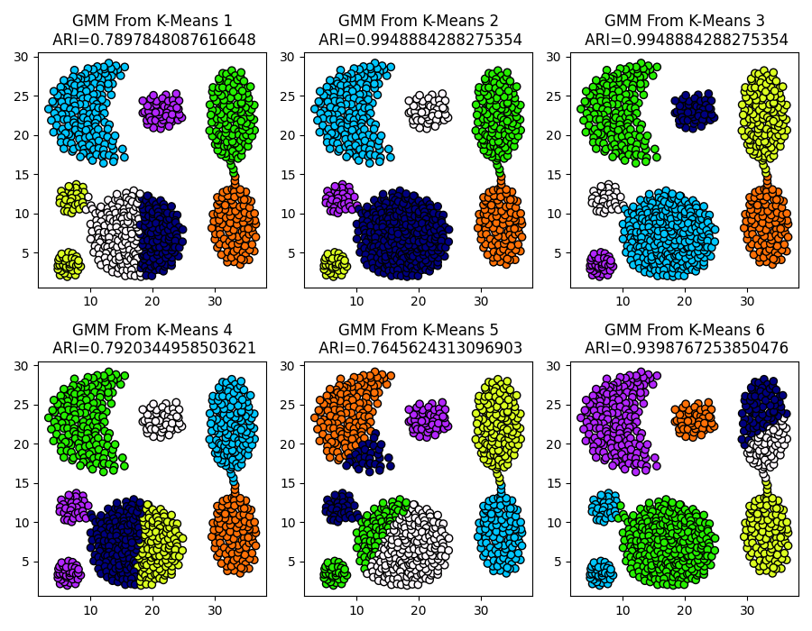
Combined method clustering results
K-Means finds cluster centers by minimizing within-cluster variance, so its centroids are often close to where Gaussians would naturally center.
K-Means runs faster than GMM so generating initial means from K-means can reduce the number of iterations EM needs to converge, reducing overall runtime.
Notes:
William

Slide 9
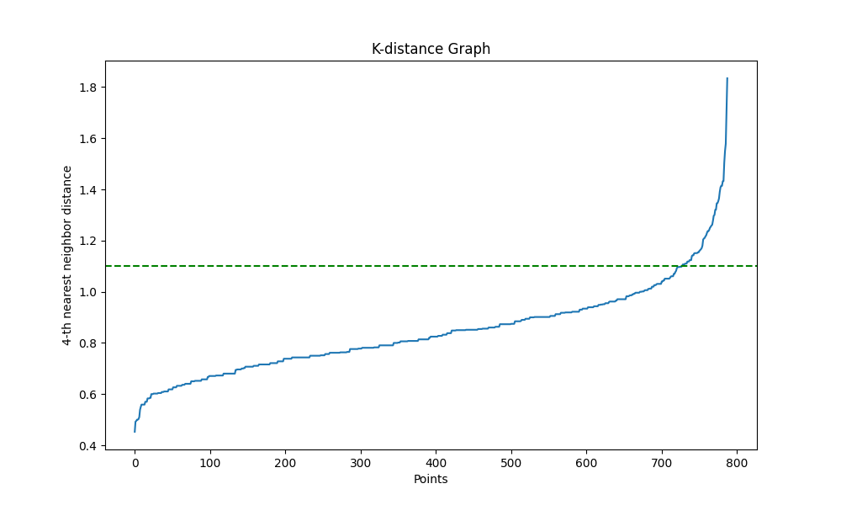
DBSCAN
Notes:
Egok

Slide 10
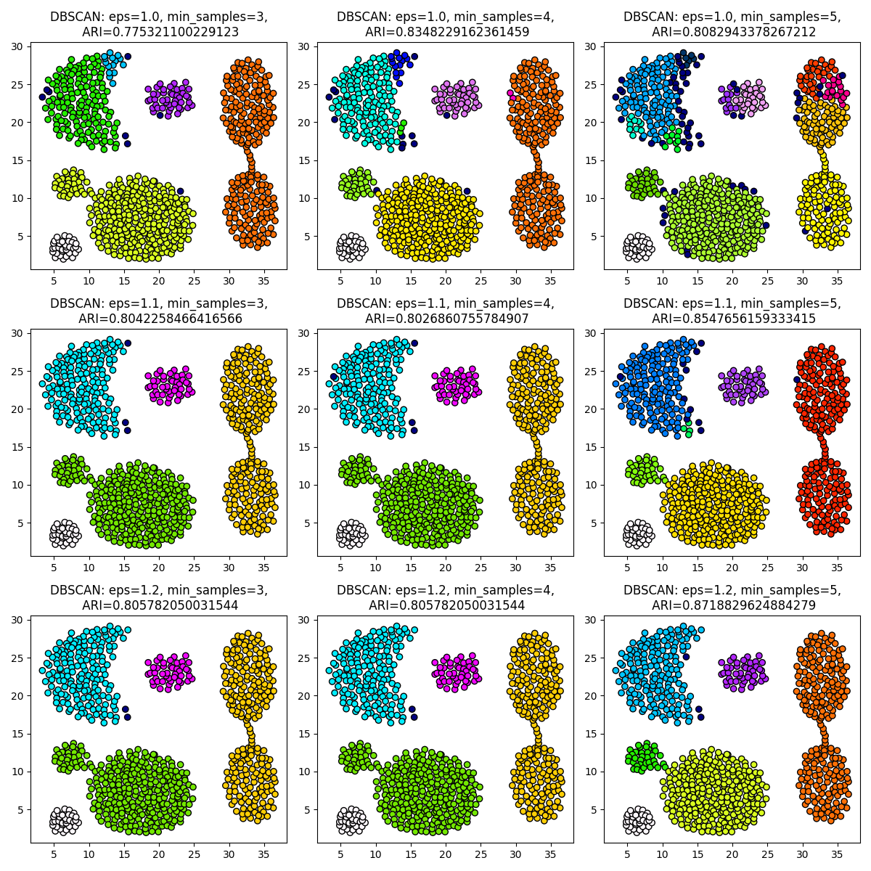
DBSCAN
Clustering
results

Slide 11
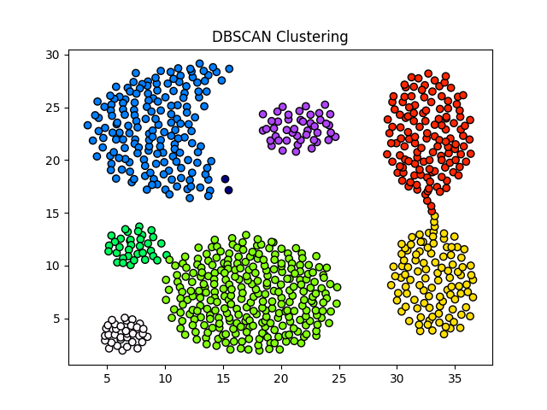
DBSCAN clustering results (ARI maximized)
ARI: 0.9917
Eps = 1.39
Min samples = 7
Notes:
Egok

Slide 12
Most suitable algorithm for Aggregation?
Algorithm | ARI (Adjusted Rand Index)
K-means | 0.704 (Average of 6 runs)
GMM | 0.857 (Average of 6 runs)
DBSCAN (pen n paper) | 0.872
DBSCAN (ARI optimized) | 0.992
Notes:
Egok

Slide 13
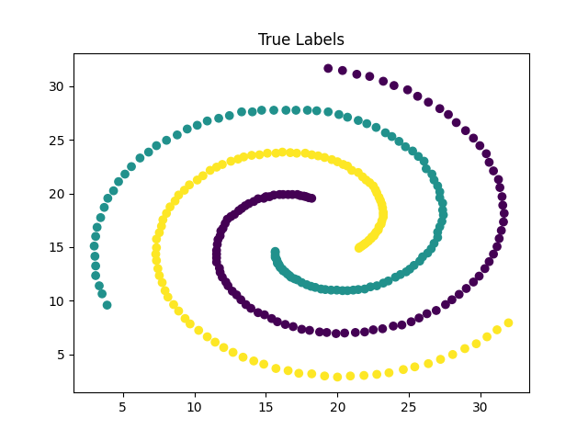
Spiral Dataset True Labels

Slide 14
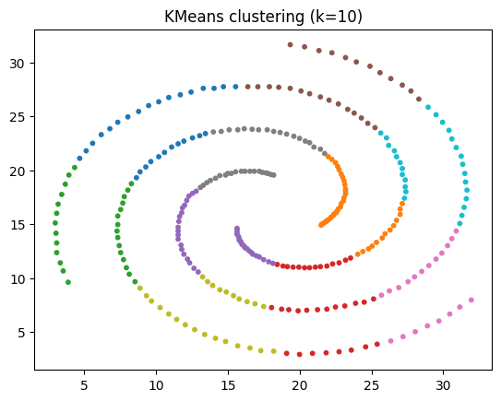
KMeans clustering results
Best ARI = 0.0865
Notes:
K-means: basic, fast, expects spherical clusters.

Slide 15
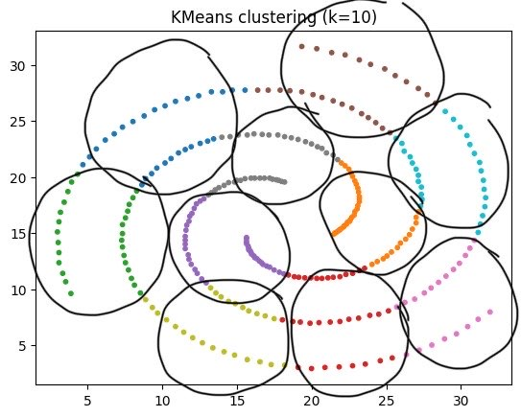
KMeans clustering results
Best ARI = 0.0865
Notes:
K-means: basic, fast, expects spherical clusters.

Slide 16
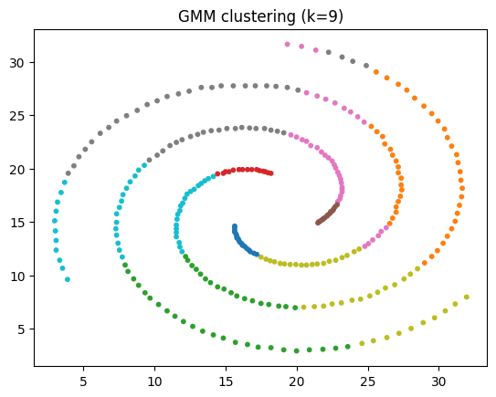
GMM clustering results
Best ARI = 0.0835
Notes:
GMM: handles flexible shapes, prefers ellipsoidal clusters.

Slide 17
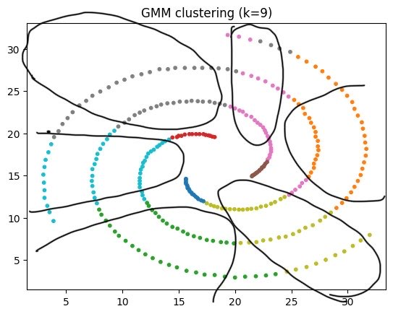
GMM clustering results
Best ARI = 0.0835
Notes:
GMM: handles flexible shapes, prefers ellipsoidal clusters.

Slide 18
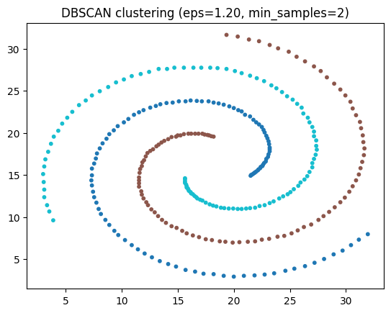
DBSCAN clustering results
Best ARI = 1.0000
Notes:
DBSCAN: captures non-linear structures like spirals

Slide 19
Most suitable algorithm for Spiral?
Algorithm | ARI
K-means | 0.0865
GMM | 0.0835
DBSCAN | 1

Slide 20
Quality Measures
Spiral | Silhouette | ARI
True labels | 0.0013 | -
K-means | 0.3695 | 0.0865
GMM | 0.1736 | 0.0835
DBSCAN | 0.0013 | 1

Slide 21
Outlier Detection
For aggregation
Distance based
  DB - outliers
  KNN
Density based
  Local outlier Factor (LOF)

Slide 22
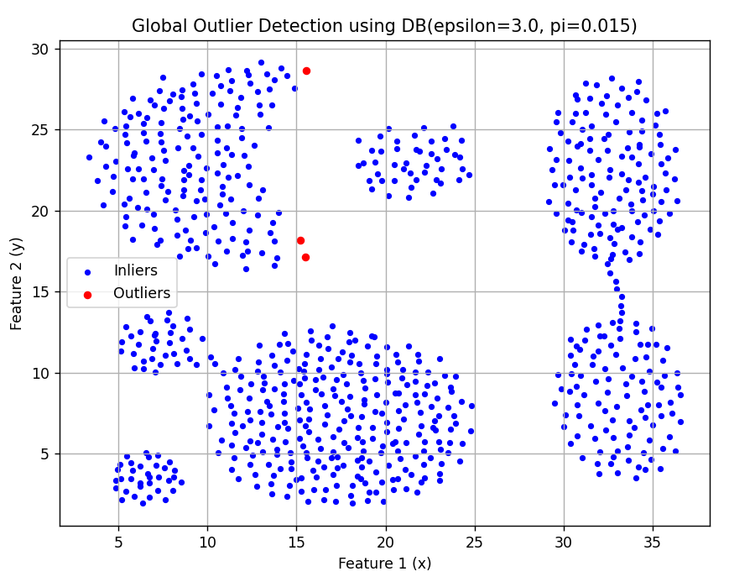

Slide 23
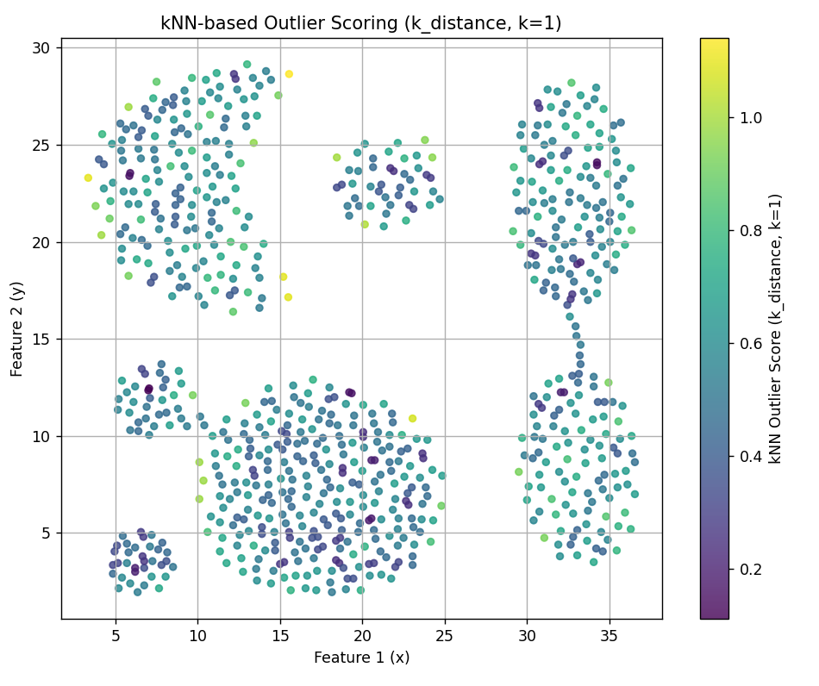

Slide 24
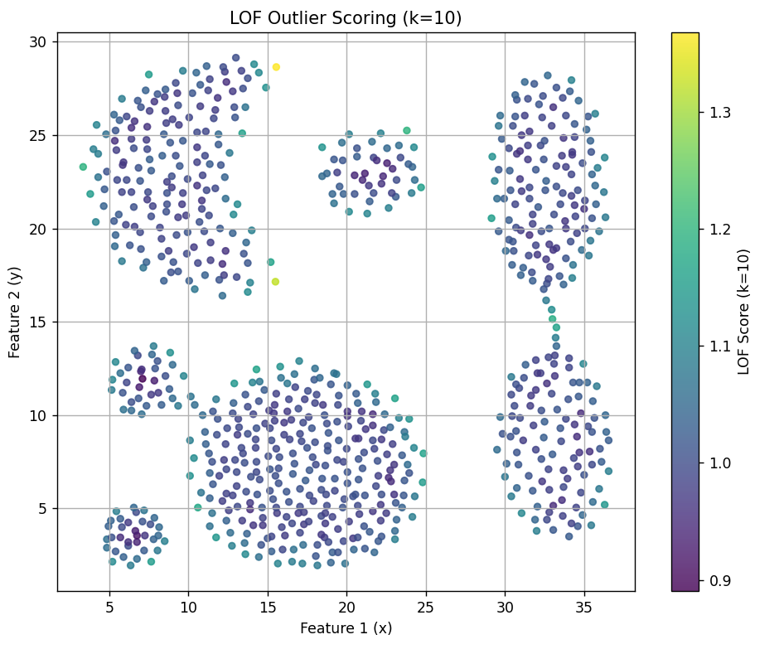

Slide 25
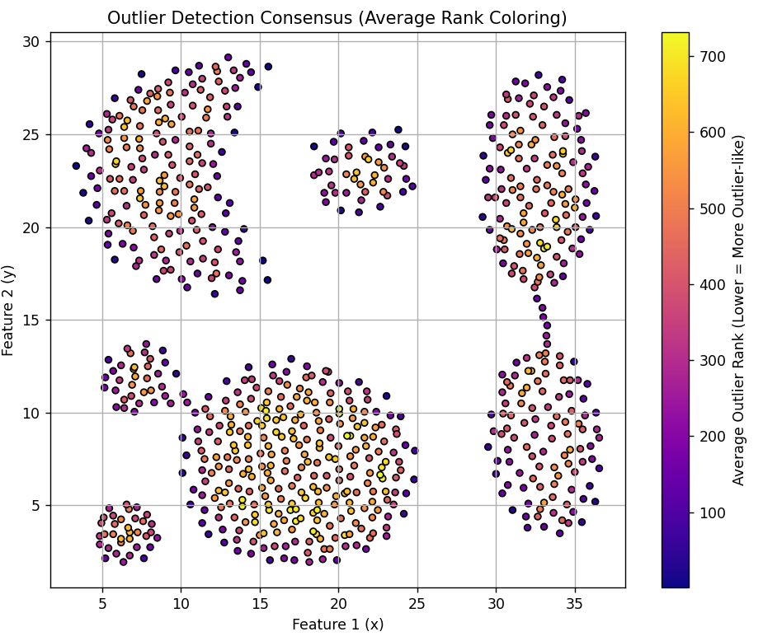
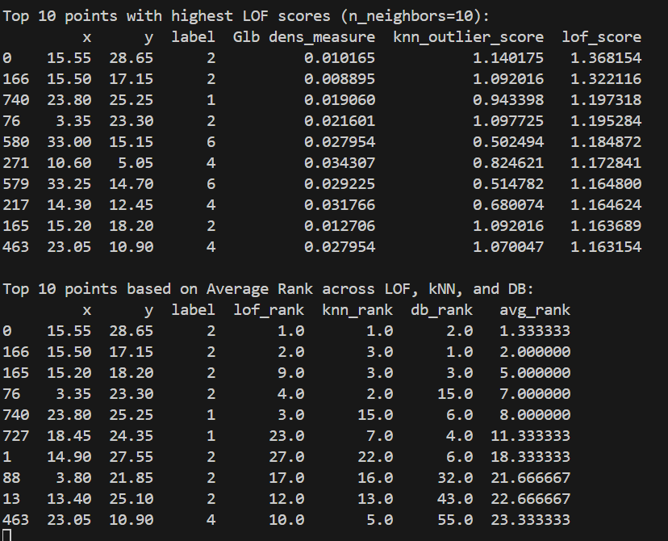

Slide 26
Wrap up

Slide 27
Thanks
Do you have any questions?

